Slide 1

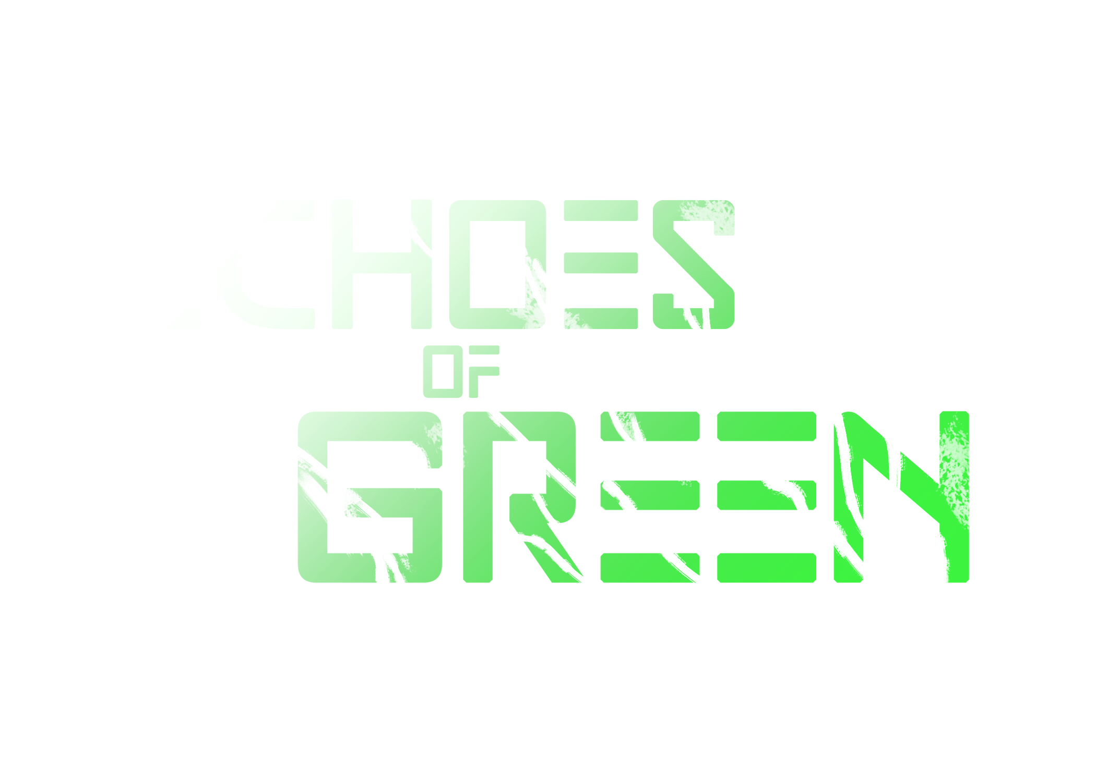

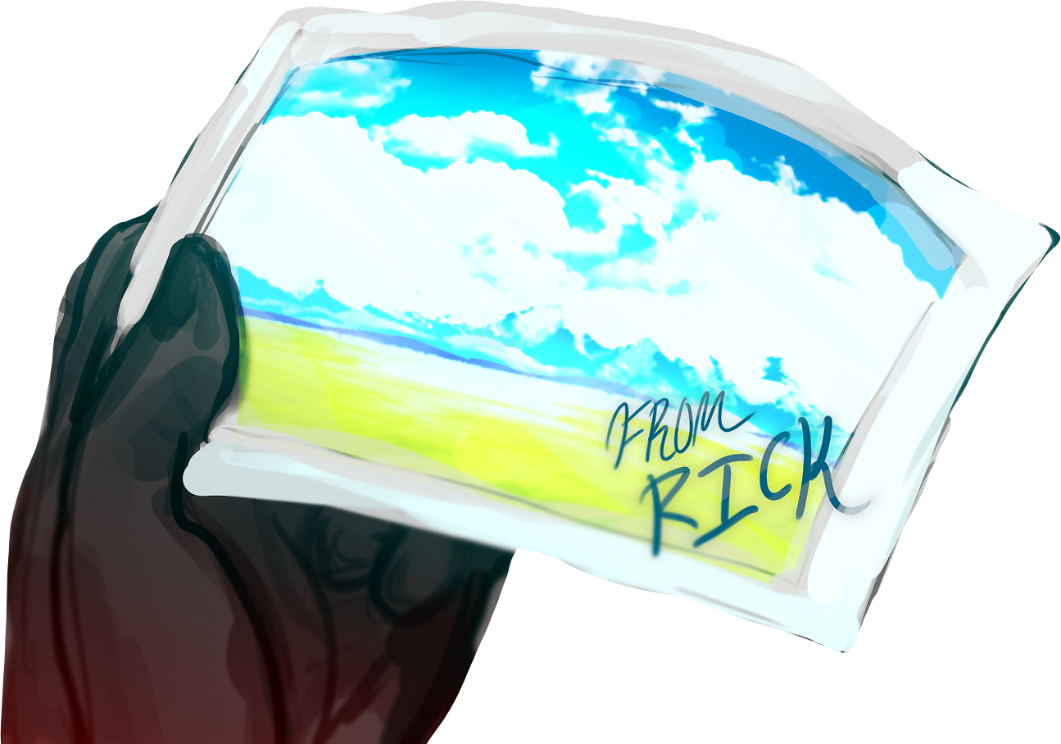
Ben Walls, Sen Seymour, Adam Goldberg, Rachelle Phipps
Hacklahoma 2025
Inspiration
Born from a fascination with dystopian worlds where nature has been completely erased
How we built it
Developed the game using Unreal Engine
Art, OST, voice acting, and cinematography using Photoshop, GarageBand, and Adobe Rush
Difficulties
Asset installation issues
Combining of code and parts
What's next for Echoes of Green
More hidden lore
Side quests that deepen the mystery
AI improvements to enhance combat
Thank you!

